Slide 1
Do Probiotics Safely and Effectively prevent Antibiotic Associated Diarrhea in pediatric patients?
By: Taiba, Katya, Raghda, Lucas, Erik

Slide 2
Clinical Scenario
Moshe, a 4 year old patient with strep throat will need to be treated with antibiotics. Last time he was on antibiotics he developed diarrhea. His mother wonders whether taking probiotics will lessen the chance of diarrhea developing. What can you tell her?

Slide 3
Clinical Question
Do probiotics safely and effectively prevent AAD in pediatric patients?

Slide 4
PICO SEARCH TERMS
P | I | C | O
Pediatric Patients on Antibiotics | Probiotics | No intervention | Prevent Diarrhea
Patients taking antibiotics in the pediatric population | Prophylactic probiotics | Placebo | Reduced Incidence of Diarrhea
Antibiotic- Associated Diarrhea | Pediatric Probiotics |  | Prevent gastrointestinal disturbance
 | Saccharomyces boulardii |  | Lessen Diarrhea

Slide 5
Search Method
Search Terms Used:
-Probiotic use for the prevention of diarrhea in pediatric patients on antibiotics
-The effect of probiotic prophylaxis in reducing diarrhea in pediatric populations
-The role of probiotics in preventing diarrhea in pediatric patients
Number of results that were applicable to our clinical question:
Pubmed Results Yielded- 27
Chocrane results yielded- 12
TRIP Database-150
Notes:
Many of the articles did not focus on the pediatric population Some of the filters we used were articles published less than 10 years ago, pediatrics, free full text, review
the MeSH Terms: anti-bacterial agents; diarrhea; probiotics
anti bacterial agents
We eliminated articles that focused on

Slide 6
Articles Selected for Appraisal
Probiotics for the prevention of pediatric antibiotic‐associated diarrhea. A Systematic Review and Meta-analysis. (GoldenBerg Et.al, 2015)
Probiotics for the prevention and treatment of antibiotic-associated diarrhea: A systematic review and meta-analysis. (Hempel S¹, et al, 2012)
Probiotics for the Prevention of Antibiotic-Associated Diarrhea in Children.A systematic review and meta-analysis (Szajewska H¹,Et.al, 2016)
Probiotics for the prevention of Clostridium difficile-associated diarrhea in adults and children. A Systematic Review and Meta-analysis. (GoldenBerg Et.al, 2017)
Systematic review with meta-analysis: Saccharomyces boulardii in the prevention of antibiotic-associated diarrhoea. (Szajewska H¹,Et.al, 2015)

Slide 7
Probiotics for the prevention of pediatric antibiotic‐associated diarrhea: A Systematic Review/Meta-Analysis
Criteria:
Randomized, parallel, controlled trials in children (0 to 18 years) receiving antibiotics
Studies that compared probiotics to placebo, active alternative prophylaxis, or no treatment and measure the incidence of diarrhea secondary to antibiotic use were considered for inclusion.
Methods:
MEDLINE, EMBASE, CENTRAL, CINAHL, AMED, the Web of Science , Cochrane IBD/FBD review group, CISCOM (Centralized Information Service for Complementary Medicine), NHS Evidence, the International Bibliographic Information on Dietary Supplements as well as trial registries were all searched for applicable articles.
Studies that were included:
23 studies with 3,948 participants were selected.
Studies included use of either Bacillus spp., Bifidobacterium spp., Clostridium butyricum, Lactobacilli spp., Lactococcus spp., Leuconostoc cremoris, Saccharomyces spp., orStreptococcus spp., alone or in combination.

Slide 8
Probiotics for the prevention of pediatric antibiotic‐associated diarrhea: A Systematic Review/Meta-Analysis
It was found that there seems to be a protective effect of probiotics in children who take antibiotics.
The number needed to treat is 10.
The two strains that were most effective were found to be Lactobacillus rhamnosus or Saccharomyces boulardii.
Clinical Application- With a low NNT and the low risk found to be associated with probiotics (side effects), probiotics SHOULD be recommended for children taking antibiotics.
BIAS/Limitations:
The risk of bias was determined to be high or unclear in 13 studies and low in 10 studies. But these studies were still used when determining a clinical conclusion, although this was mentioned and addressed.
Some of the measurements to make conclusions were not easily quantified, leaving room for bias.
Notes:
A subgroup analysis of those trials rated as a low risk of bias versus those rated as exhibiting a high risk of bias showed statistically significant results for the low risk studies (RR 0.42; 95% CI 0.30 to 0.60) and high risk studies (RR 0.50; 95% CI 0.33 to 0.77 ). A test for interaction was not statistically significant (P = 0.54). Additionally, summary statistics from the subgroups for high risk of bias and low risk of bias did not exhibit an inverse trend between quality and therapeutic effect. In other words, as quality (e.g. randomization, blinding, allocation concealment) increased, the therapeutic effect of probiotics did not decrease.

Slide 9
2) Probiotics for the prevention and treatment of antibiotic-associated diarrhea: a systematic-review and meta-analysis (Hemple, S., et al, 2012)
CRITERIA:
Parallel RCTs that compared probiotic use as adjunct antibiotic treatment with a concurrent control group receiving no treatment, placebo, or a different probiotic or probiotic dose were eligible for inclusion in the review.
Participants of all ages treated with antibiotics, regardless of the indication and the patients' underlying symptomatology, were included.
Interventions based on the genera Lactobacillus, Bifidobacterium, Saccharomyces, Streptococcus, Enterococcus, and/or Bacillus alone or in combination
METHODS:
Searched 12 electronic databases (DARE, Cochrane Library of Systematic Reviews, CENTRAL, PubMed, EMBASE, CINAHL, AMED, MANTIS, TOXLINE, ToxFILE, NTIS, AGRICOLA), from database inception to February 2012 without language restriction, to identify probiotics publications.
STUDIES INCLUDED:
Two independent reviewers identified RCTs of prevention as well as treatment of AAD.
Of 15, 214 titles, 82 RCT’s met inclusion criteria.

Slide 10
2) Probiotics for the prevention and treatment of antibiotic-associated diarrhea: a systematic-review and meta-analysis (Hemple, S., et al, 2012) (Cont’d)
CONCLUSIONS:
The pooled relative risk in a DerSimonian-Laird random-effects meta-analysis of 63 RCTs, which included 11,811 participants, indicated a statistically significant association of probiotic administration with reduction in AAD (relative risk, 0.58; 95% CI, 0.50 to 0.68; P < .001; I(2), 54%; [risk difference, -0.07; 95% CI, -0.10 to -0.05], [number needed to treat, 13; 95% CI, 10.3 to 19.1]) in trials reporting on the number of patients with AAD.
LIMITATIONS/BIAS:
The quality of the reporting was low; 59 trials lacked adequate information to assess the overall risk of bias.
Half the RCTs reported only the genus and species that were used in the intervention but not the strain (41/82), and many did not state that treatment allocation was concealed (64/82), or did not report an intention-to-treat analysis (31/82).
However, 53 of the 82 trials reported that participants and outcome assessors were blind to the intervention. Seventeen trials were classified as industry sponsored; 52 did not clarify the role of funding, questions about conflict of interest remained, or both; and 13 trials explicitly stated no competing interest.

Slide 11
3) Probiotics for the Prevention of Antibiotic-Associated Diarrhea in Children. (Szajewska H¹,Et.al, 2016)
Criteria
Pediatric patients aged 2 weeks to 18 years evaluated for the use of different probiotic to reduce or cessate antibiotic associated diarrhea. 6 taxonomic groups of probiotics and the results in relation to patients with AAD.
Methods
the Cochrane Database of Systematic Reviews and the Database of Abstracts of Reviews of Effects (DARE). CENTRAL (Cochrane Central Register of Controlled Trials), MEDLINE, EMBASE, PubMed.
Studies that were included:
Systematic Review with Meta-analysis of 22 randomized control trials with 3255 pediatric patients

Slide 12
3) Results on the Use of Probiotics
Conclusion
The pooled results of 21 RCTs showed that compared with placebo or no intervention, probiotics as a class reduced the risk of AAD by 52%
Difficult to identify which probiotic correlates the best with antibiotic use.
Recommend use of Lactobacillus rhamnosus GG (LGG) or Saccharomyces boulardii for pediatric patients on oral antibiotics
Kefir and Yogurt had no effect on reducing the risk of AAD.
Limitations
Affective probiotic is related to the type of antibiotic given to the pediatric patient

Slide 13
4) Probiotics for the prevention of Clostridium difficile-associated diarrhea in adults and children.
Criteria:
Randomized controlled (placebo, alternative prophylaxis, or no treatment control) trials investigating probiotics (any strain, any dose) for prevention of CDAD, or C. difficile infection in adult (> 18 years) and pediatric patients (0 to 18 years of age) receiving antibiotic therapy for any reason.
Outcomes Studied:
Primary outcome was the incidence of CDAD
Secondary outcomes included detection of C. difficile infection in stool, adverse events, antibiotic‐associated diarrhea (AAD) and length of hospital stay.
Methods:
PubMed, EMBASE, CENTRAL, and the Cochrane IBD Group Specialized Register were searched from inception to March 21, 2017.
Extensive grey literature search was conducted.
Studies that were included:
31 randomised controlled trials including 8672 participants
RCT’s reporting incidence outcomes for CDAD (diarrhea and detection of C. difficile toxin in stool) or detection of C. difficile (detection of C. difficile or toxin in stool)

Slide 14
4) Probiotics for the prevention of Clostridium difficile-associated diarrhea in adults and children.
Conclusion:
Moderate quality evidence supports a large protective effect for probiotics (eg. S. boulardii or L. acidophilus + L casei at a dose of 10 to 50 billion CFUs per day) in preventing Clostridium difficile‐associated diarrhea.
Probiotic prophylaxis would prevent 85 Clostridium difficile‐associated diarrhea episodes per 1000 patients at high risk of C. difficile diarrhea. (NNTB* was 12)
Although adverse effects were reported among 32 included trials, there were more adverse events among patients in the control groups.
Short-term use of probiotics appears to be safe and effective when used along with antibiotics in patients who are not immunocompromised or severely debilitated.
Bias/Limitations:
10 of the 31 studies were rated as having a low risk of bias, while 21 were rated as having a high or unclear risk of bias.
Sensitivity analysis showed that the low risk of bias studies suggested a similar protective effect of probiotics as the high risk of bias studies, and a test of interaction between low and high or unclear risk of bias studies was not statistically significant (P = 0.93)
Notes:
*Number needed to treat for an additional beneficial outcome (NNTB)

Slide 15
5) Systematic review with meta-analysis: Saccharomyces boulardii in the prevention of antibiotic-associated diarrhoea.
Criteria: Children and adults that received antibiotics for any reason. Patients in the experimental group received S. boulardii any dose/duration. The control groups received placebo or no additional intervention
Methods: The Cochrane Central Register of Control Trials, MEDLINE, and EMBASE databases were searched for relevant RCTs up until May 2015. Search words that were used were: diarrhea, antibiotic-associated diarrhea, Clostridium difficile, Helicobacter pylori, probiotics and Saccharomyces boulardii
Studies that were included: 21 randomized control trials (4780 participants: 2441 in the experimental group and 2339 in the control group) Children and adults age not specified. 12 trials - placebo control studies, 15 trials- Adult, 6 trials- children

Slide 16
5) Systematic review with meta-analysis: Saccharomyces boulardii in the prevention of antibiotic-associated diarrhoea.
Major Findings:
Treatment with S. boulardii compared with placebo or no treatment decreased the risk of AAD in patients treated with antibiotics from 18.7% to 8.5% (RR: 0.47, 95% CI: .38-.057, random effect model).
For every 10 patients receiving daily S. boulardii with antibiotics, one fewer would develop AAD. (NNT: 10, 95% CI: 9-13)
There was a reduction in AAD in both children and adults. In children compared with placebo or no treatment, S. boulardii reduced the risk of diarrhea from 20.9% to 8.8% (6 RCTs n=1653, RR: 0.43 95% CI: .30-.60, NNT: 9, 95% CI: 7-12 ) In adults: reduced risk of diarrhea from 17.4% to 8.2% (15 RCTs RR= .49 95% CI: 0.38-0.63 NNT 11)
Significant evidence also showed that S. boulardii may reduce the risk of C.difficile- associated diarrhea in children.
Limitations/Bais:
A limitation was that the trials included varied in methodological quality. Only 2 of the articles chosen were at low risk of bias. There were also inconsistencies between the articles in the way they defined AAD/ diarrhea. Many trials had a small sample size or lacked sample size calculations. Article is from Poland and includes adults.
Notes:
One strength of this this systematic review and meta analysis is that it focuses exclusively in only one probiotic S. boulardii, and therefore the findings of the article can be directly applied to clinical practice
Last point: However the total sample size in the meta-analysis was sufficient to draw reliable conclusions

Slide 17
Summary of Mini CAT Grid
The level of evidence involved systematic review, meta analysis and randomized control trials.
Sample settings included multiple RCTs and involved 3,000 to 12,000 participants.
Outcomes studied:
Prevention/treatment of AAD
Probiotic use is dependent on type of antibiotic treatment
Probiotics for the prevention of Clostridium difficile-associated diarrhea in adults and children
There is evidence that probiotics are beneficial and outweigh the risks
The systematic review and meta analyses that were included in in this appraisal stated that many trials included had high risk of bias, however the biases were not significant enough to invalidate the results. Minimal heterogeneity was detected when comparing.

Slide 18
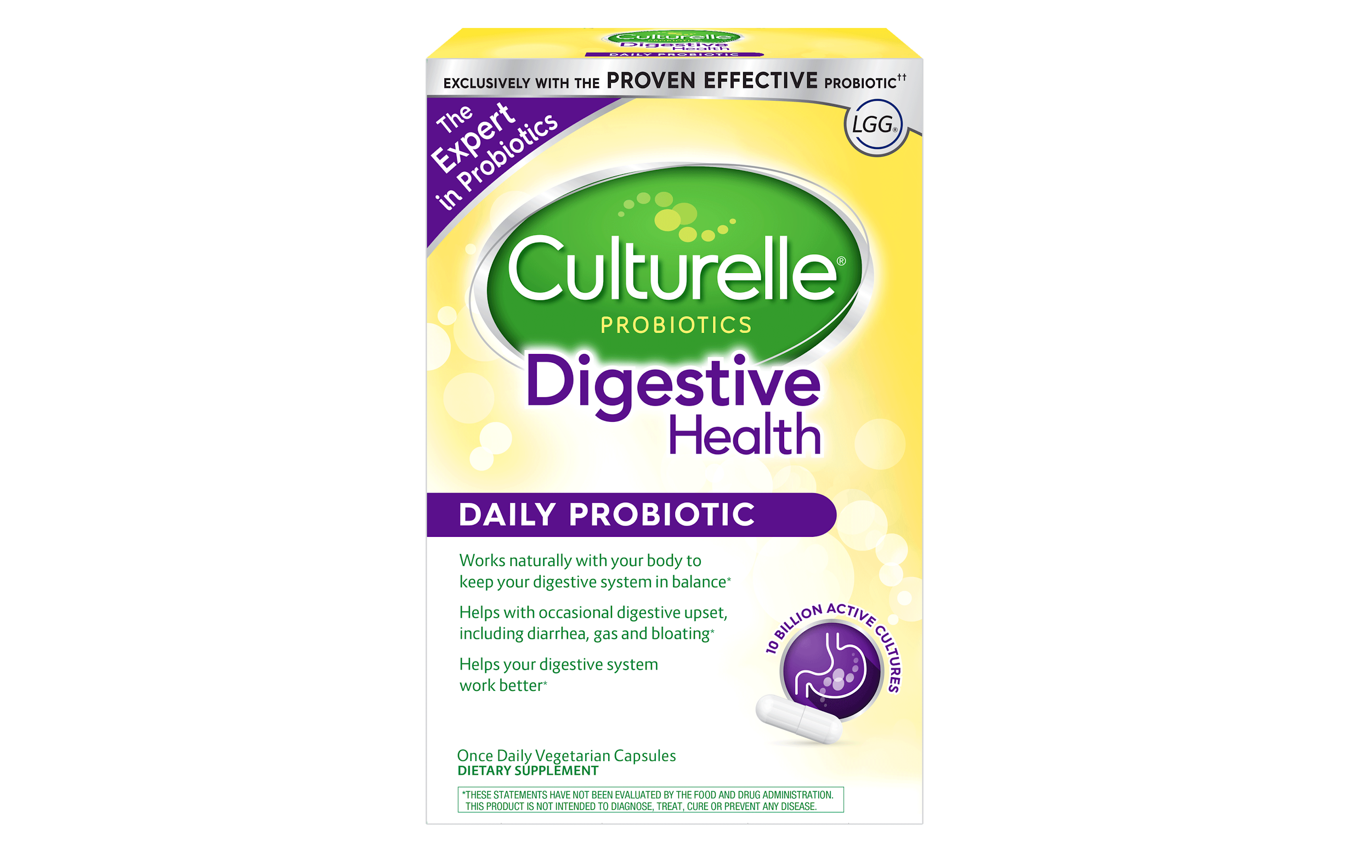
Clinical Bottom Line
The highest levels of evidence state that providing probiotics to children on antibiotics reduces the incidence of antibiotic-associated diarrhea.
We would recommend that parents administer probiotics (particularly Lactobacillus rhamnosus or Saccharomyces boulardii) during antibiotic use in children up until the age of 18.

Slide 19
References
1) Probiotics for the prevention of pediatric antibiotic‐associated diarrhea
Joshua Z Goldenberg, Lyubov Lytvyn, Justin Steurich, Patricia Parkin, Sanjay Mahant
2) Probiotics for the prevention and treatment of antibiotic-associated diarrhea: a systematic review and meta-analysis. Hempel S¹, Newberry SJ, Maher AR, Wang Z, Miles JN, Shanman R, Johnsen B, Shekelle PG.
3) Probiotics for the Prevention of Antibiotic-Associated Diarrhea in Children. Szajewska H¹, Canani RB, Guarino A, Hojsak I, Indrio F, Kolacek S, Orel R, Shamir R, Vandenplas Y, van Goudoever JB, Weizman Z
4) Probiotics for the prevention of Clostridium difficile-associated diarrhea in adults and children.
Goldenberg JZ¹, Yap C, Lytvyn L, Lo CK, Beardsley J, Mertz D, Johnston BC.
5) Systematic review with meta-analysis: Saccharomyces boulardii in the prevention of antibiotic-associated diarrhoea. Szajewska H, Kołodziej M.

